Slide 1
Auction Markets
Jon Levin
Winter 2010
Economics 136

Slide 2
FCC and Radio Spectrum
FCC regulates use of electromagnetic radio spectrum: used for broadcast TV, radio, cell phones, WiFi, etc.
Why regulate?
  There is a limited amount of spectrum
  There are many potential users
  There are interference problems if users overlap.
So, how should the FCC decide who gets a license to use spectrum?
Historically, licenses were allocated administratively (TV & radio stations) or by lottery.

Slide 3
Spectrum auctions
Coase (1959) suggested that the FCC should auction spectrum licenses.
  If there were no transaction costs, the initial assignment of ownership wouldn’t matter (the Coase Theorem).
  But the real world isn’t like that… decentralized trade may not lead to efficient allocations (more on this later).
In the early 1990s, the FCC started to think about auctions as a way to allocate licenses efficiently, and adopted a new design proposed by Stanford economists.
  Many countries now use auctions that result in hundreds of millions, or billions, of dollars of government revenue.

Slide 4
Sponsored search auctions
Google revenue in 2008: $21,795,550,000.
Hal Varian, Google chief economist:
  “What most people don’t realize is that all that money comes pennies at a time.”
Google revenue comes from selling ads: there is an auction each time someone enters a search query
  Bids in the auction determine the ads that appear on the RHS of the page, and sometimes the top.
  Google design evolved from earlier, and problematic, design used by Overture (now part of Yahoo!)
We will see that Google’s design is closely related to the theory of matching we’ve already studied.

Slide 5
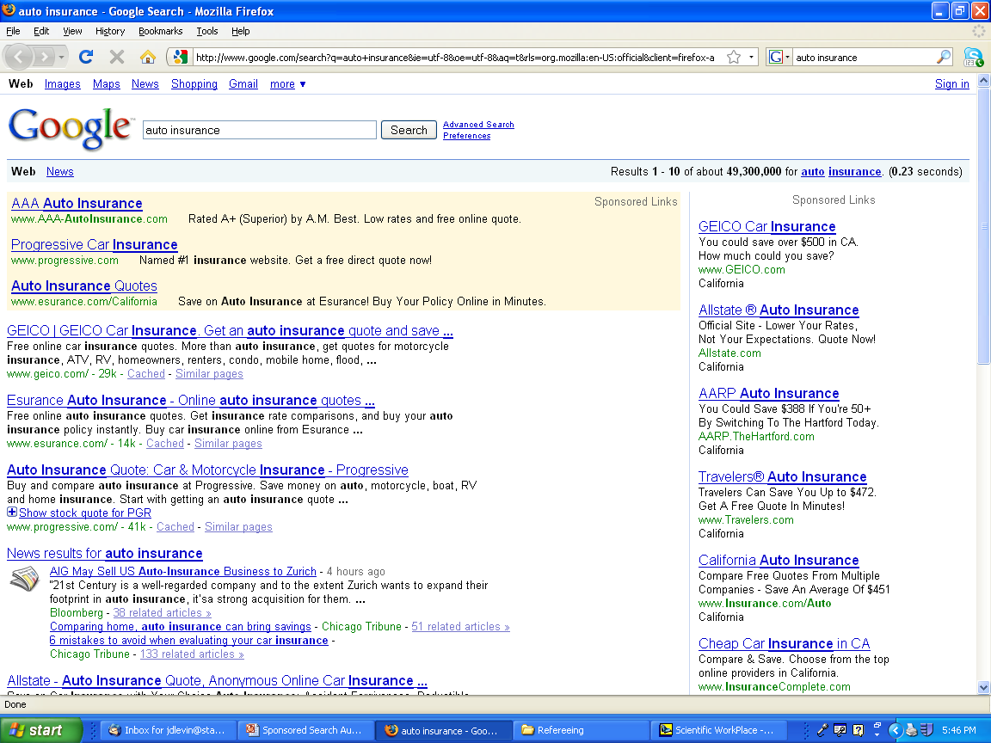

Slide 6
British CO₂ Auctions
In 2002, the British government decided to spend £215 million paying firms to reduce CO₂ emissions.
  But what price to pay per unit? And which firms to reward?
  Solution: run an auction to find the “market price”
Greenhouse Gas Emissions Trading Scheme Auction
  Price starts high and decreases each round.
  Each round, bidders state tons of CO₂ they will abate
  Cost to UK: tons of abatement times price.
  Auction ended when total cost equaled the budget.
Result: 34 firms paid to reduce emission by a total of 4 million metric tons of CO_{2.}
Notes:
Since this was a procurement auction (the gov’t procured emission reductions), it was run as a descending “clock auction”. Designed and run for DEFRA (British equivalent of EPA) by Peter Cramton, Larry Ausubel and Eric Maskin (and coded by Ulrich Gall!). Clearing defined by price × quantity ≤ budget of £215 million. Clock started at a price of £100 per metric ton and descended to a clearing price of £53.37 per metric ton.

Slide 7
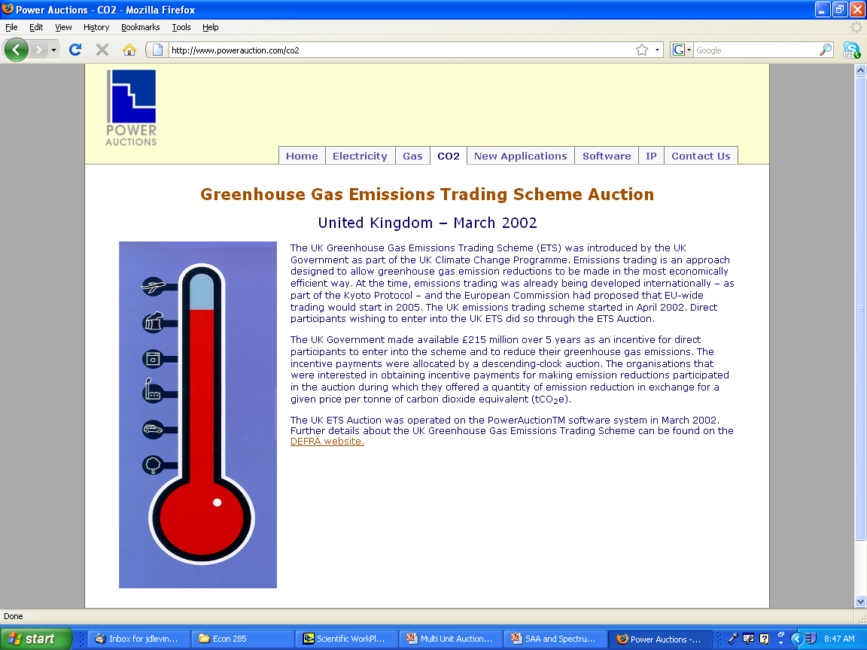

Slide 8
Auctions everywhere…
Auctions are commonly used to sell (and buy) goods that are idiosyncratic or hard to price.
  Real estate
  Art, antiques, estates
  Collectibles (eBay)
  Used cars, equipment
  Emissions permits
  Natural resources: timber, gas, oil, radio spectrum…
  Financial assets: treasury bills, corporate debt.
  Bankruptcy auctions
  Sale of companies: privatization, IPOs, take-overs, etc.
  Procurement: highways, construction, defense.
Auction theory also has close and beautiful ties to standard price theory (monopoly theory) and matching.

Slide 9
Auction Theory

Slide 10
Selling a single good
We’ll start with sale of a single good (later, consider many goods).
Why not just set a price?
  Seller may not know what price to set.
  Potential buyers know what they’d pay, but aren’t telling.
  Remember from last time – auction serves as a mechanism for price discovery.
Let’s consider different ways to run an auction.

Slide 11
Canonical model
Potential buyers
  Two bidders (later N bidders)
  Each bidder i has value v_{i}
  Each v_{i} drawn from uniform distribution on [0,1].
Same ideas will apply with N bidders and a value distribution other than U[0,1].
Seller gets to set the auction rules.

Slide 12
Ascending auction
Price starts at zero, and rises slowly.
Buyers indicate their willingness to continue bidding (e.g. keep their hand up) or can exit.
Auction ends when just one bidder remains.
Final bidder wins, and pays the price at which the second remaining bidder dropped out.
How should you bid?

Slide 13
Ascending Auction
Optimal strategy: continue bidding until the price just equals your value.
Bidder with highest value will win.
Winner will pay second highest value.
Example with three bidders
  Suppose values are 25, 33, and 75.
  First exits at 25, second at 33 and auction ends.

Slide 14
Ascending auction revenue
Suppose we repeatedly take two draws from U[0,1].
  On average, the highest draw will be 2/3
  On average, the second highest will be 1/3.
So the average (or expected) revenue from an ascending auction with two bidders who have values drawn from U[0,1] is 1/3.
If we have N bidders with values drawn from U[0,1]
  on average, the highest draw will be N/N+1
  and the second highest draw will be (N-1)/(N+1).
  So the expected revenue will be (N-1)/(N+1).

Slide 15
Aside: Order Statistics
One draw
0
1/2
1
Two draws
0
1/3
2/3
1
Three draws
0
1/4
2/4
3/4
1

Slide 16
Ascending auction profit
Suppose values are drawn from U[0,1]. What profit does a bidder with value v expect?
  His probability of winning is v (why?)
  If he wins, he gets the object worth v
  He also pays the highest losing value.
  If he wins, he expects on average to pay half his value (why?), or v/2.
So average (or expected) profit for value v bidder:
v [v-v/2] = v²[1/2] = (1/2)v².

Slide 17
Second price auction
Bidders submit sealed bids.
Seller opens the bids.
  Bidder who submitted the highest bid wins.
  Winners pays the second highest bid.
How should you bid?

Slide 18
Second price auction
Theorem. The optimal strategy in the second price auction is to bid your value.
Proof
Suppose you bid b>v.
  If the highest opposing bid is less than v, or higher than b, it makes no difference.
  If the highest opposing bid is between v and b; you win if you bid b, but pay above your value, so better to bid v.
Suppose you bid b<v.
  Only matters if the highest opposing bid is between b and v. Then bidding v is better – you win and pay less than your value.

Slide 19
Second price auction
Bid true value v
0
If opponent bid is here,
win and make money
v
If opponent bid is here,
lose the auction
1
Bid b>v
0
1
If opponent bid is here,
win and make money
v
If bid is here, win but lose money!
b
If opponent bid is here,
lose auction

Slide 20
Second price auction
In equilibrium, everyone bids their value.
  Bidder with highest value wins.
  Pays an amount equal to second highest value.
Exactly the same as the ascending auction!
  i.e. same winner, same revenue, same expected profit for a bidder with value v.

Slide 21
Vickrey auction
Second price auction is an example of a more general “Vickrey” auction that can be used to sell multiple goods.
Rules for Vickrey auction (will return to this later)
  Everyone submits their value(s)
  Seller allocates to maximize surplus
  Set prices so the profit of each winner equals his contribution to the total surplus – the difference between social surplus if he is or is not counted as a participant.
  Equivalently, each winner pays the externality he imposes by displacing other possible winners.
Think about how the 2nd price auction does this!

Slide 22
Sealed tender
Bidders submit sealed bids.
Seller opens the bids and
  Bidder who submitted highest bid wins.
  Winner pays his own bid.
Now what is the optimal strategy?

Slide 23
Sealed tender, cont.
Best to submit a bid less than your true value.
How much less?
Submitting a higher bid
  increases the chance you will win
  increases the amount you’ll pay if you do win
Optimal bid depends on what you think the others will bid (unlike in the second-price auction!).
We need to consider an equilibrium analysis.

Slide 24
Nash equilibrium
Defn: A set of bidding strategies is a Nash equilibrium if each bidder’s strategy choice maximizes his payoff given the strategies of the others.
  In an auction game, bidders do not know their opponent’s values, i.e. there is incomplete information.
  So each bidder’s equilibrium strategy must maximize her expected payoff accounting for the uncertainty about opponent values.

Slide 25
Solving the sealed bid eqm
Suppose j≠i uses the strategy: bid b_{j}= βv_{j}.
  Bidder i understands j’s strategy (the eqm assumption), but doesn’t know j’s bid exactly because he doesn’t know v_{j}.
Suppose i bids b_{i} . He’ll win with probability
  Pr(b_{i}>βv_{j})= Pr(b_{i}/β >v_{j})= b_{i}/β
So bidder i’s bidding problem is
max_{b} (b/β)(v_{i}-b)
First order condition for optimal bidding
0 = (1/β)(v_{i}-b) – (b/β)

Slide 26
Solving for equilibrium
First order condition
0 = (1/β)(v_{i}-b) – (b/β)
Re-arranging and cancelling out
b/β = (1/β)(v_{i}-b)
b = v_{i}-b
b =(1/2)v
At symmetric equilibrium, b_{i}=(1/2)v_{i}, b_{j}=(1/2)v_{j} --- both bidders bid half their value.
With N bidders, equilibrium is b=[(N-1)/N]v.

Slide 27
Sealed bid equilibrium
We’ve derived the eqm: b(v)=(1/2)v
Bidder with the highest value wins in eqm.
What is the revenue, on average?
  Revenue equals bid of the high value bidder
  High value, on average, is 2/3
  So highest bid, on average, is 1/3
Same as the ascending and second price!
Is it the same for each realization of bidder values?
  Example: suppose bidder values are ¾ and ½.

Slide 28
Descending price
Price starts high (at least $1).
Price drops slowly (continuously).
At any point, a bidder can claim the item at the current price (and pay that price).
Auction ends as soon as some bidder claims item.
How should you bid?

Slide 29
Descending price
Strategically equivalent to the first price auction!
  Suppose the bidders had to send in computer programs to do the bidding … it would be a 1st price auction!
  Does actually being there make it any different?
  No, in both auctions, your bid only matters if you are the winner or tied for winning – a slightly lower bid means paying less if you win, but maybe you lose out.
  For any strategies by opponents, bidder i chooses the stopping price (bid) to maximize Pr(win)(v-b) – same problem as in the first price auction.
So … eqm strategies in first price and descending auction are the same, and so is expected revenue.

Slide 30
All-pay auction
Bidders submit bids
Seller opens bids
Bidder submitting the highest bid wins
All bidders pay their bids.
How should you bid?

Slide 31
All pay auction
Clearly want to bid less than your value
Bidding more means
  Greater chance of winning
  Pay more for sure
Suppose we find equilibrium bid strategies.
  How will the bids compare to the first-price auction?
  Will seller raise more or less revenue in equilibrium?

Slide 32
Comparison of Auctions
At least in our example, a number of standard auctions share the following properties of bidders play according to equilibrium.
  the allocation is efficient
  average revenue is the same
  average profit of a value v bidder is the same.
Next time we’ll explore this result further.

Slide 33
Bidder Strategy

Slide 34
Are bidders really strategic?
Game theory models of auctions assume that bidders understand the environment and behave strategically. A good assumption?
Consider two examples:
  “Skewed bidding” in Forest Service auctions
  “Excessive bidding” in internet auctions

Slide 35
Scoring rule auctions
In many auctions, bidders don’t just bid a price, but many prices that are combined into a “score”.
The score determines who wins, but the “unit prices” determine the eventual payments.
  Contractors bid an hourly rate for labor and a cost for materials. Owner picks the bid that appears the most cheapest but actual payment depends on the work done.
  Firms bidding for timber in the national forests bid a unit price for each species. The prices are multiplied by the estimated quantities to determine the winner.
What are the bidders’ incentives?

Slide 36
Timber auction example
Forest Service estimates there are 100 mbf of Douglas Fir and 100 mbf of Western Spruce.
Bidders make “per-unit” bids for Fir and Spruce.
  A bidder offers prices of $50 and $60.
  Total bid is 100*50 + 100*60 = $11,000.
High bid wins, but payment depends on actual quantities.
  Suppose the ($50,$60) bid wins.
  Estimated quantities are 100, 100; expected payment $11,000.
  But if the actual quantities are 100 of fir and 50 of spruce, the actual payment is 100*50 + 50*60 = $8,000.

Slide 37
Bidding incentives
Suppose FS estimates (100,100) of fir, spruce.
Bidder can submit a total bid of $10,000 by:
  Bidding $50 for Fir and $50 for Spruce.
  Bidding $100 for Fir and $0 for Spruce
  Bidding $0 for Fir and $100 for Spruce.
Suppose bidder estimates (200,0) for fir, spruce.
  The three alternative bids lead to expected payments of $10,000, $20,000, and $0!
  Incentive to “skew” one’s bid onto the species you think the seller has over-estimated!

Slide 38
Are bids skewed?
Athey and Levin (2001) show that there is a lot of skewed bidding in Forest Service auctions.
FS revenue is about $10,000 less per sale than if total bids were the same but “balanced”.
But, in sales when FS made a mistake, total bids were higher, so there is no correlation between FS mistakes and actual revenue.
Explanation?
  Bidders appear to game the auction by making bids for which they expect to pay less.
  But since they’re all doing it, they have to bid more to win – they compete away the potential profit from gaming!

Slide 39
Overbidding at eBay
Lee and Malmendier (2010) document “excessive” bidding in eBay auctions.
Look at auctions for a game: Cashflow 101.
Available from two eBay retailers for $129.95.
Auction prices on eBay can exceed this:
  42% of auctions in their data!
  73% if one accounts for shipping costs.
What should we make of this?

Slide 40
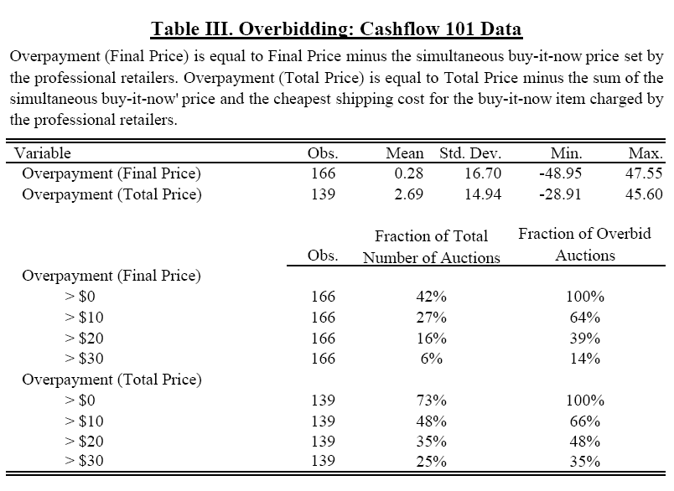
Source: Lee and Malmendier (2010)

Slide 41
Overbidding at eBay, cont.
Does everyone overbid?
  Appears to be a small number of bidders: only 17% of bidders ever bid above the retail price.
  Maybe auctions let you “fish for fools”?
How general is the phenomenon?
  Appears to be relatively common in other categories, not a specific “Cashflow 101” effect.
So again, what do we make of it?

Slide 42
Swoopo Auction
Swoopo sells common products by auction.
Auction rules
  Placing a bid costs $0.50.
  Price starts at $0, and clock starts to run down.
  If there are bids before clock runs out, new round.
  In each new round, price increases by $0.10.
  If clock expires, auction ends. Standing high bidder is the winner and pays the current price.

Slide 43


Slide 44
Excess Bidding
Data from 650 auctions of $50 bills
  Average revenue: $104!
More generally, Augenblick examines data from over 100,000 Swoopo auctions….

Slide 45
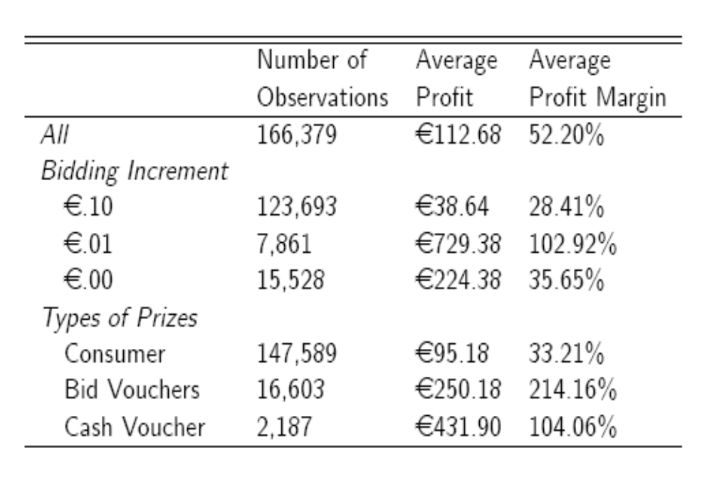
Excessive bidding?

Slide 46
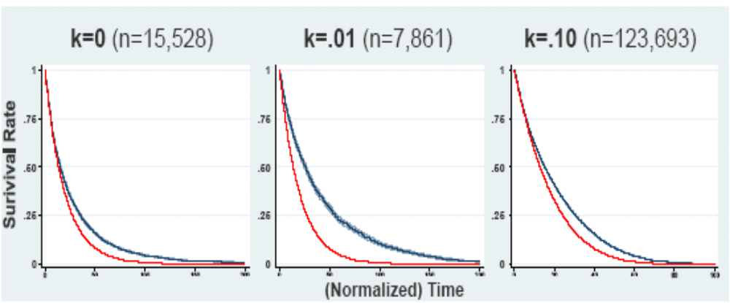
Ending Times: Theory vs Data

Slide 47
Revenue Equivalence

Slide 48
Background
We saw that (in theory) some common auction designs all lead to efficient outcomes and yield the same revenue, at least on average.
Next:
  How general is this result?
  Why is this the case?
  What are the implications?
  and then a bit of empirical evidence.

Slide 49
Canonical model
Potential buyers
  Two bidders.
  Bidder i has value v_{i}
  Each v_{i} drawn from uniform distribution on [0,1].
Our next result also applies with N bidders so long as their values come from the same distribution (doesn’t have to be a uniform distribution).
Seller gets to set the auction rules.

Slide 50
Revenue equivalence theorem
Thm. Consider the model on the last slide and any auction game with the feature that in equilibrium,
  the bidder with the highest value wins, and
  if a bidder has the lowest possible value, he pays nothing.
The average revenue and bidder profits in this auction game are the same as in the 2nd price auction.
Examples: the four main auctions from before
  Ascending auction
  Second price sealed bid
  Descending auction
  First price sealed bid

Slide 51
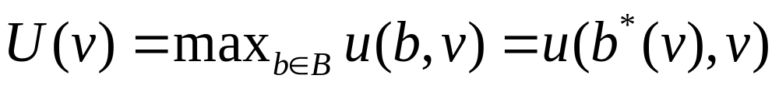
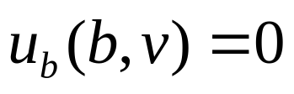
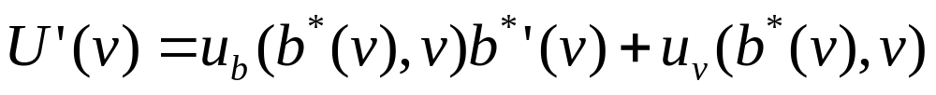
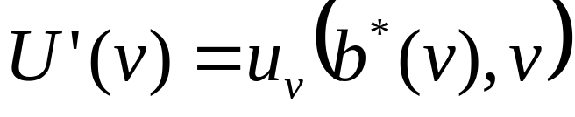
Envelope Theorem
Consider a parameterized maximization problem
Maximization means that when b=b*(v)
By the chain rule for differentiation
The envelope theorem says that

Slide 52
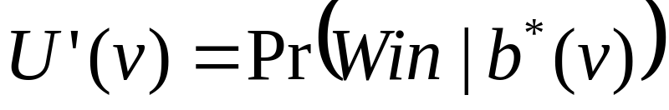
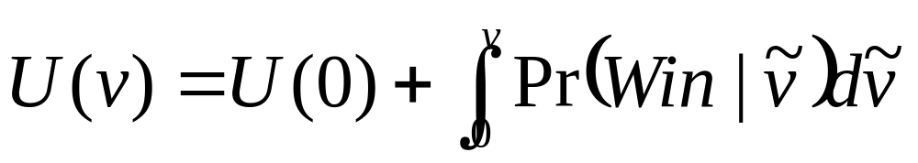
Proof of the RET
Consider auction game each bidder has to submit a “bid” b. (sealed bid, stopping price..)
Bidder with value v solves
Let U(v) be the bidder’s expected profit, i.e. the “value” of the bidding problem. The Envelope Theorem says
So the bidder’s expected profit is

Slide 53
Math behind the RET, cont.
So, independent of the exact auction rules (how bids determine the winner and payments), a bidder’s expected profit depends only on his equilibrium probability of winning as a function of his value.
So if some auction game always results in the same allocation (same winner) as the 2nd auction, it must have the same expected bidder profits.
It must also have the same expected revenue. Why?
  Revenue equals the total surplus minus the sum of the bidder profits, and both of these are the same across auctions!

Slide 54
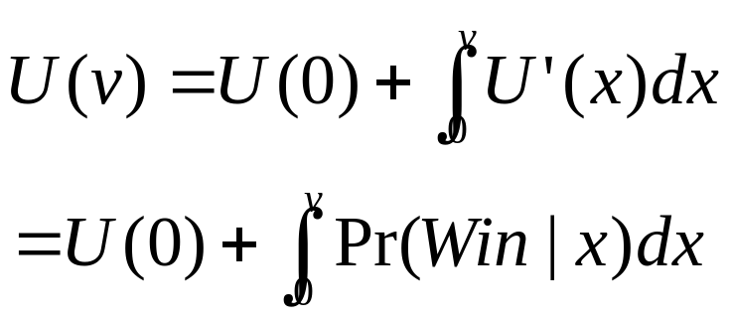


Revenue Equivalence Recap
Bidder values drawn from same distribution.
Standard auction with equilibrium in which high value bidder wins.
Expect payoff if value v
Using calculus
RET: if two auctions would result in the same winner, they have the same bidder profits, and hence seller revenue.
“Envelope” argument

Slide 55
“Hidden” assumptions
Bidders know their own values
  What if they may want to resell the good?
  What if another bidder has relevant information?
Bidder values are independent.
  Bidder i and j will have same belief about k’s value.
  What if bidders conduct surveys of the same oil field?
Bidder’s care about their auction profits
  Value of the object minus the price they pay.
  If opponent wins, don’t care about what it pays.
  No “risk aversion” if auction outcome is uncertain.

Slide 56
RET as a benchmark
The revenue equivalence theorem is a central result in auction theory, but it depends on strong assumptions.
Many important results in economics are similar in their dependence on implausible assumptions
  Modigliani-Miller capital structure theorem
  Ricardian equivalence theorem
  First & second welfare theorems
  Coase theorem
What is the significance of these kinds of results?

Slide 57
Evidence on RET

Slide 58
Does the RET Really Hold?
Not in laboratory experiments
  Bidders behave as predicted in ascending auctions, but tend to bid “too much” in first and second price auctions, and descending auctions!
  There is some evidence, however, that this goes away with more “experienced” bidders.
What about in actual markets?

Slide 59
USFS Timber Auctions
The US Forest Service sells timber from the national forests – sometimes by open auction and sometimes by sealed bid.
Athey, Levin and Seira (2008) use data from these auctions to test predictions of the RET.

Slide 60
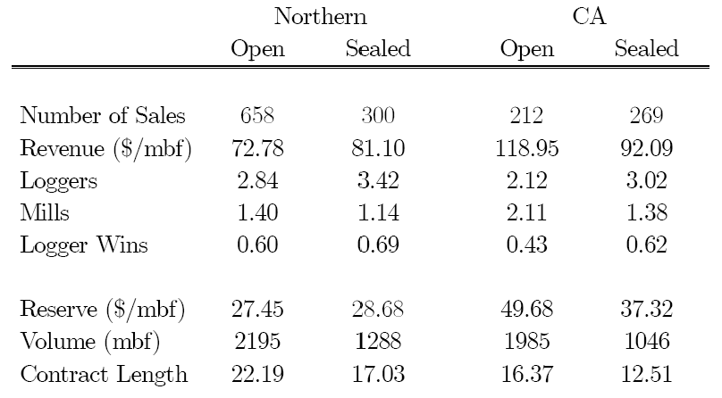
Data from Timber Auctions

Slide 61
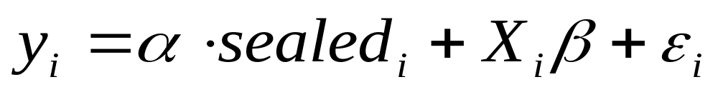
Empirical Test
Tracts of timber sold by open and sealed bid auction are not identical
  California: small sales are usually sealed and large sales usually open – have to control for auction size.
  Idaho/Montana: format was partially randomized but varied by location and date of sale – have to control for date/area.
Solution: estimate regression model
where “outcome” can be participation, revenue, etc.

Slide 62
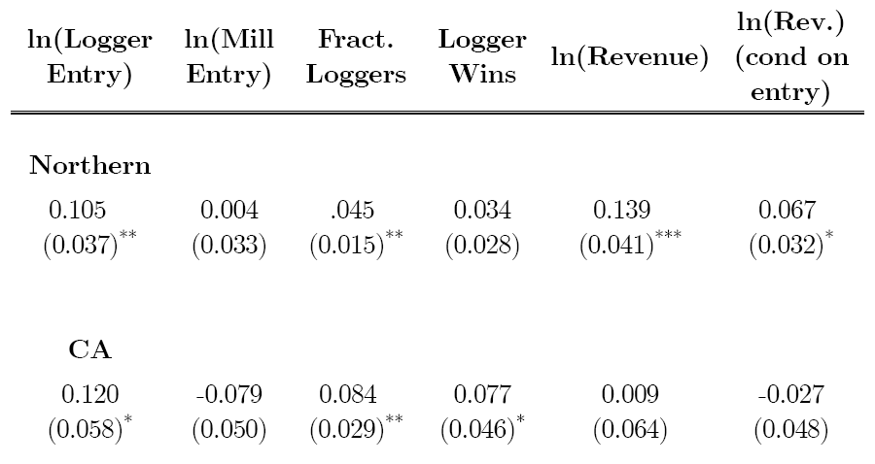
Estimated effect of sealed bidding
More loggers at sealed bid auctions!
Logger more likely to win
a sealed bid auction
Revenue advantage for sealed bidding?

Slide 63
Explaining the results
Basic RET assumed symmetric bidders, but here we have small “loggers” and large “mills” competing.
What happens with weak and strong bidders?
  Open auction: outcome is still efficient – high value wins.
  Sealed auction: strong bidders may “shade” bids a lot, and so weak bidders win more often.
So theory predicts weak bidders will do better (attend more, win more) with sealed bidding.

Slide 64
Combining theory and data
Athey-Levin paper asks
  Suppose mills draw their values from one distribution and loggers from another: what distributions are consistent with the data?
  Can do this for the open and/or the sealed bid auctions.
How do we infer value distributions from bidding data?
  One approach: pick a distribution of values, simulate a lot of auctions, see if the simulation data is similar to the actual data; iterate until you find a good fit.
  In practice, can be a bit more nuanced.

Slide 65
Findings
California
  The data matches the theory very closely.
Idaho/Montana
  The data doesn’t match the theory as wel: the prices in the open auctions are “too low” relative to what the theory predicts.
  Why? Maybe bidders aren’t competing hard in the open auctions – they bid “as if” they have low values.
  Why might open auctions be vulnerable to collusion?

Slide 66
Applying the RET

Slide 67
Applying the RET
The basic idea of the RET is that so long as the equilibrium of the auction leads to the high value bidder winning
  The bidders will make the same expected profits as in the 2nd price auction
  The seller will make the same expected revenue as in the 2nd price auction
Now let’s consider some applications…

Slide 68
Solving the first-price auction
Two bidders and values U[0,1].
  In a 2nd price auction, a bidder with value v will win with probability v and expects to pay v/2 when he wins.
  Suppose the first price auction has an equilibrium where bidders use an increasing bid strategy b(v), so the high value bidder wins.
  A bidder with value v must expect to pay the same as in a 2nd price auction, i.e. to pay v/2 if he wins.
  In the first-price auction, if the winner with value v pays his bid b(v) if he wins, so therefore b(v)=v/2.

Slide 69
All-pay auction
Everyone puts their bid in an envelope and mails the money to the seller.
The seller keeps the bids, and gives the object to the highest bidder.
What are the equilibrium bids?
Suppose there’s an equilibrium in which a higher value leads to a higher bid – then high value bidder will win, and we can use the RET to find out what the bids must be!

Slide 70
Solving the all-pay auction
Two bidders and values U[0,1].
  In a 2nd price auction, a bidder with value v will win with probability v and expects to pay v/2 when he wins.
  So his overall expected payment is v²/2.
  Suppose the all pay auction has an equilibrium where bidders use an increasing bid strategy b(v), so the high value bidder wins.
  A bidder with value v must expect to pay the same as in a 2nd price auction, i.e. v*v/2=v²/2
  In the all-pay auction equilibrium, each bidder pays its bid with probability 1, so the bid strategy must be b(v) = v²/2!

Slide 71
Bidding with Reserve prices
Again consider two bidders with values U[0,1].
Consider a second price auction where the seller sets a reserve price r below which she will not sell.
  A bidder with value below r won’t bid,
  A bidder with value v>r bids her value.
Suppose a bidder has value v>r.
  Expects to win with probability v.
  Conditional on winning, will pay either r or opponent value.
  Expects to pay (r/v)*r + [(v-r)/v]*(v+r)/2 if he does win.
  Re-writing expected payment: r+[(v-r)/v]*(v-r)/2.

Slide 72
First price auction with reserve
Look for an equilibrium where high value bidder wins if his value is above the reserve price.
By RET, in the first price auction equilibrium,
  A bidder with v<r doesn’t bid.
  A bidder with v>r bids b(v)=r+[(v-r)/v]*(v-r)/2.

Slide 73
Reserve prices and revenue
Can a reserve price increase revenue?
Suppose there is just one bidder with value v distributed uniformly between 0 and 1.
Setting a reserve price r means
  No sale with probability r
  Sale at price of r with probability 1-r
  Want to maximize r(1-r) => r=1/2!
Same as the monopoly price for a seller facing a linear demand curve Q(p)=1-p. Why?

Slide 74
Reserve prices, cont.
Suppose there are two bidders with values U[0,1].
Consider choosing r or slightly more r+Δ
  Doesn’t matter if both values above r+Δ or below r.
  Increases revenue by Δ if one bidder has value above r+Δ and one has value below, i.e. with prob. 2r(1-r)
  Decreases revenue by r if one bidder has value between r and r+Δ, and the other has value below, i.e with prob. 2Δr.
At the optimal r, small change can’t matter, so we must have Δ*2r(1-r)= r*2Δr.
Optimal reserve: r=1/2 – same as with one bidder!

Slide 75
Reserve price and RET
The optimal reserve price is independent of the number of bidders.
And by RET, it’s the same in the first and second price auction (and ascending/descending).
Is it the same in the all-pay auction?
  No – but can still use RET logic.
  If r* is the optimal reserve in the second-price auction, and b(v) is the all-pay eqm, the optimal all-pay reserve is R*=b(r*).

Slide 76
Buy-it-Now Auctions
Two bidders with values U[100,200]
Seller runs ascending auction where bidders can “buy-it-now” at price p.
Claim: buy it now will be used at least some of the time if p<50.
  Suppose opponent never buys it now.
  If a buyer with value v doesn’t buy it now, he expects to win with prob. (v-100)/200 and pay (100+v)/2, so expected profit (v-100)²/400.
  Buyer can buy it now for profit v-p, so best to buy-it-now if v-p > (v-100)²/400 – if p=150, buy-it-now if v>158.

Slide 77
Buy-it-Now Auctions
Buy it now equilibrium: each bidder tries to buy it now if v>v*, otherwise waits and bids.
  Here v* is such that v* bidder is just indifferent between buying it now and waiting, given the other bidder tries to buy it now if his v>v*.
Claim: introducing “buy it now” reduces profit.
  With values drawn U[100,200], MR>0 for all v.
  So optimal auction awards object to high bidder.
  May not happen with buy it now: because both bidders may try to buy it now, leading to coin flip!

Slide 78
RET and Bargaining
Consider bargaining situation as follows
  Seller with value s drawn U[0,1]
  Buyer with value v, also drawn from [0,1].
In a “bargaining protocol”, the seller and buyer report their “bids/offers” – and the mechanism determines whether or not they should trade and who pays/receives what.

Slide 79
Examples
Buyer, seller submit offers b, s (or can opt out)
  If B,S opt in, trade at price 1/2 (posted price)
  If b>s, trade at price b (buyer offer )
  If b>s, trade at price s (seller offer )
  If b>s, trade at price (b+s)/2 (split the difference)
  If both bid, trade for sure at offer closer to 1/2 (arbitration)
Dynamic bargaining
  Seller and buyer alternate making offers
  Seller makes offers, buyer says when to accept
  Actually fits into this framework if we think of bid b and offer s as bargaining strategies rather than numbers.

Slide 80
Vickrey “pivot” mechanism
Seller and buyer make bid and ask offers.
The parties trade if and only if b>s.
If trade takes place,
    The seller receives a price b
    The buyer pays a price s
This mechanism is strategy-proof (optimal to offer true value/cost) and leads to efficient trade.
But the payments don’t balance – whenever there is trade, the mechanism requires a subsidy of v-s.

Slide 81
Vickrey mechanism
Buyer: bid true value v
0
If seller offer is here,
trade at price s<v
v
If seller offer is here,
don’t trade
1
Buyer: bid b>v
0
1
If seller offer is here,
trade at price s<v
v
If seller offer is here, trade at price > v!
b
If seller offer is here, don’t trade

Slide 82
Cost of Vickrey Mechanism
If v>s, trade occurs
  Gains from trade v-s
  Subsidy required is also v-s
Expected outcomes
  Expected gains from trade: E[max{v-s,0}] = 1/6
  Expected buyer profit: 1/6
  Expected seller profit: 1/6
  Expected subsidy: 1/6

Slide 83
Efficiency in Bargaining?
Analogue of the RET for bargaining says that any bargaining protocol that leads to efficient trade must give buyer and seller the same profit they’d get under the Vickrey mechanism.
Theorem. There is no bargaining protocol in that always leads to efficient trade and does not require an external subsidy!
Proof.
  Under Vickrey mechanism, expected surplus is E[max{v-s,0}], buyer profit is E[max{v-s,0}] and seller profit is E[max{v-s,0}].
  These numbers are the same in any efficient mechanism.
  So buyer and seller profit minus surplus created is E[max{v-s,0}], which can only happen if there is an outside subsidy!

Slide 84
Auctions vs Bargaining
Recall Coase’s argument for FCC auctions.
  If licenses are allocated according to some inefficient process, parties may not trade to realize the efficient allocation.
  Myerson-Satterthwaite Theorem provides a rigorous justification: bargaining with private information is inherently inefficient!
  But in many cases, it is possible to run an efficient auction (in the symmetric U[0,1] case, any standard auction will do!).

Slide 85
Optimal Auctions

Slide 86
Optimal auctions
A version of the RET says that the expected revenue from any auction will be the expected marginal revenue from the winning bidder.
The “optimal auction” would award the object to the bidder with highest marginal revenue, conditional on his marginal revenue being positive.

Slide 87
Reserve price example
Two bidders with values U[0,100]
  Define P(q)=100-100q
  Define MR(q)=100-200q
For a given value v, the corresponding “quantity” is the probability of having a value more than v, so MR(v)=100-2(1-v/100).
The auction maximizes the seller’s revenue if
  The bidder with highest value wins, and the object is awarded if and only v>50.
  A first-price auction or a Vickrey auction with reserve price of 50 is revenue-maximizing!

Slide 88
Optimal Auctions
Myerson’s Theorem. Across all auctions, the following achieves the maximum expected revenue:
  Bidders report their values to seller.
  Bidder with highest MR wins, provided his MR>0.
  Winner pays an amount equal to the least value he could have reported and still won.
Notes
  Payment rule ensures that auction is strategy-proof.
  If bidders are symmetric, optimal auction is a standard auction with a reserve price.
  If asymmetric, optimal auction biases the allocation toward bidders with high MRs, but perhaps lower values.

Slide 89
“Asymmetric” Bidders
Two bidders with values U[20,60] and U[0,80]
  Bidder 1: P(q)=60-40q and MR(q)=60-80q
  Bidder 2: P(q)=80-80q and MR(q)=80-160q
Marginal revenue as a function of value
  If value is v, then q is prob. of higher value.
  Bidder 1: MR(v) = 2v-60
  Bidder 2: MR(v) = 2v-80
Revenue-maximizing auction (picture)

Slide 90
Optimal auction
MR
Bidder 1 could have lower value, but
higher marginal revenue.
80
MR₁(v)=2v-60
MR₂(v)=2v-80
40
0
40
v₁
v₂*
80
-40
If bidder 1 has value v₁, he
wins if v₂ < v₂*!
The optimal auction is biased toward bidder one!
-80

Slide 91
Relation to Monopoly Theory
Two Stanford GSB professors, Jeremy Bulow and John Roberts, wrote a famous paper that explained optimal auctions as identical to monopoly pricing.
Each bidder is analagous a separate “market” in which the good can be sold.
Quantity is analogous to probability of winning.
The monopolist can price discriminate, setting different prices in different markets.
Allocating the probability of winning to individual bidders is analogous to allocating quantities across separated markets.
The best strategy for a monopolist is to allocate quantity to the market where marginal revenue is highest, and the same is true for the auctioneer!

Slide 92
Marginal Revenue
There is a useful connection to monopoly theory.
Define a bidder’s “demand” at price p to be the probability his value is above p
Define his inverse demand P(q) to be the price at which there is probabilty q he will buy.
Example, a bidder has value U[20,60]
  The bidder’s demand is P(q)=60-40q.
  The “revenue” curve is R(q)=qP(q)=60q-40q²
Define the bidder’s marginal revenue as dR(q)/dq.
  If values are U[20,60], MR(q)=60-80q.

Slide 93
Marginal Revenue Recap
From RET analysis, bidder profits and seller revenue are determined by the auction allocation – who wins as a function of the bidder values.
Optimal auction design: choose the “revenue-maximizing” allocation rule.

Slide 94
Optimal Auction Design
v₂
Efficient allocation: e.g. vickrey auction
Bidder 2 wins
What happens if
bidder 1 wins a
bit more often?
Bidder 1 wins
v₁

Slide 95
Marginal Revenue Recap
P
Probability bidder would pay a price p defines demand curve for a bidder
v
MR(v)=marginal revenue
from allocating a bit more quantity to the bidder (by letting him win when his value is v-dv rather than just above v)
MR(v)
P(q)
0
1-F(v)
1
Q
MR(q)

Slide 96
Optimal Auction Design
v₂
What happens if
bidder 1 wins a
bit more often?
For each value v of bidder 1 that gets a little extra chance of winning, seller gains MR₁(v)
Bidder 2 wins
For each value v of bidder 2 that gets a little less chance of winning, seller loses MR₂(v)
Bidder 1 wins
v₁

Slide 97
Expected revenue
Starting from the case where the item is never sold, seller gains MR1(v) when allocates probabilty to type v of bidder 1, and MR2(v) when allocates probability to type v of bidder 2.
So expected revenue from the auction, is average marginal revenue of the winner!

Slide 98
Optimal Auction Design
v₂
Bidder 2 wins
Optimal auction awards item to bidder with the higher marginal revenue.
MR₁(v₁) =MR₂(v₂)
Bidder 1 wins
v₁

Slide 99
Optimal Auction Design
v₂
Bidder 2 wins
MR₁(v₁) =MR₂(v₂)>0
Reserve price used to ensure no bidder wins with a negative marginal revenue!
MR₁(v₁)=MR₂(v₂)=0
MR₁(v₁)<0
MR₂(v₂)>0
Bidder 1 wins
No sale
v₁

Slide 100
Summary
RET is powerful tool for thinking about auctions (or bargaining situations) where bidders have private information.
With symmetric bidders many auctions have the property that
  In equilibrium, the high value bidder wins.
  Exp. revenue and bidder profit are identical to a Vickrey auction.
Auctioneer may want to distort efficiency to increase revenue
  Reserve price – even with symmetric bidders
  Biasing the auction to favor high MR bidders.
Concerns we haven’t yet discussed
  Getting bidders to show up
  Getting bidders to bid competitively

Slide 101
Common Value Auctions

Slide 102
Wallet auction
What’s for sale: the money in my wallet.
Second-price auction
How much will you bid?

Slide 103
Wallet auction
What’s for sale: the money in my wallet.
Second-price auction
What if one person gets to look in the wallet.
Does this change your bid? Why?

Slide 104
The winner’s curse
Winning the wallet means that everyone else in the class was more pessimistic about its contents.
Winning is “bad news”
  If you had an initial estimate of $100, knowing that everyone else had a lower estimate should cause you to revise your estimate downward.
Equilibrium bidding should account for this.

Slide 105
Common value auctions
“Imperfect estimate” model
  Two bidders with common value v
  Bidder 1 has estimate s₁ = v+e₁
  Bidder 2 has estimate s₂ = v+e₂
  Errors e₁,e₂ are independent
  Second price auction
How should bidders account for the winner’s curse in equilibrium?

Slide 106
Equilibrium bidding
Claim: In the equilibrium of the second price auction, bidders use the strategy b(s_{i})=E[v|s_{i},s_{j}=s_{i}]
Proof.
  Suppose b(s) is an equilibrium bid strategy. Then i prefers to bid “as if” his value is s_{i} as opposed to s_{i}-ds or s_{i}+ds.
  Changing the bid a little will matter if and only if bidder j bids exactly b(s_{i}), that is, if j has the same value.
  In order that i not want to slightly raise or lower his bid, winning and finding out that j has exactly the same value must result in zero profit.
  Therefore b(s_{i})=E[v|s_{i},s_{j}=s_{i}].

Slide 107
Winner’s or Loser’s Curse?
Does accounting for the information of other’s mean you bid higher or lower than your baseline estimate?
Case 1: 10 bidders, 1 item, second price auction.
  Eqm: b(s) = E[v|s is tied for highest estimate] < E[v|s].
  There is a winner’s curse.
Case 2: 10 bidders, 8 items, ninth price auction.
  Eqm: b(s) = E[v|s is tied for eigth highest estimate] > E[v|s]
  There is a loser’s curse!

Slide 108
Revenue Equivalence?
Milgrom-Weber: If bidders have “correlated” estimates of a common value item, an open auction leads to higher revenue than sealed bid auction.
Intuition.
  In either case, the high estimate bidder will win.
  In first price sealed bid auction, the payment will be independent of the estimate of the second highest bidder.
  In an ascending auction, the payment will depend on the second highest estimate.
  The bidder estimates are correlated.
  So open auction sets the price for the winner high when the other bidder has good new about the value, and sets it low when the other bidder has bad news.
  This reduces the winner’s profit and increases revenue!

Slide 109
“Linkage principle”
Broader principle: suppose the seller can give bidders access to better information. Then revenue is increased on average by making the information publicly available.
Intuition:
  The public information can either increase or decrease everyone’s bids (depending on if it’s good or bad news).
  The public information will tend to be good news exactly when the high bidder has a high value.
  So releasing information “squeezes” the high bidder in the right cases.

Slide 110
Information aggregation
How many miles is it to drive from New York to Chicago?

Slide 111
Information aggregation
Suppose we have many bidders, and each has an independent estimate s_{i} = v+e_{i.}
Average of the bidder’s estimates s_{i} is likely to be a very good estimate of v. Why?
  Avg(s_{i}) = Avg(v+e_{i}) = v+Avg(e_{i}) ≈ v.
“The wisdom of crowds”; Galton example.

Slide 112
Information aggregation
Suppose we have many bidders, and each has an independent estimate s_{i} = v+e_{i.}
If the bidders compete in a (first or second price or ascending) auction, is the resulting price a good estimate of v?
  Answer of Stanford profs Wilson, Milgrom
  In certain cases YES!, auction prices aggregate information.

Slide 113
Information Aggregation
In certain cases, auction prices aggregate information, so that the auction price is a “good” estimate of true value. Why?
Example:
  Bidder estimates are s_{i} = v+e_{i.}
  Second price auction, b_{i} = E[v| s_{i} is tied for high s]
  Order bids so that b₁ >b₂ > … >b_{N}
  Price = b₂ = E[v| s₂ is tied for high s]
  With many bidders then “s₂ is tied for high s” is basically a correct hypothesis, so b₂ is an accurate estimate!
There is one hidden assumption, which bidders with very extreme estimates are in fact quite confident about the value.

Slide 114
Information Aggregation
Signals
if true value
is low
Signals
if true value
is high
Very high
signal is very
informative!
This signal is also very informative
if you assume it’s highest.

Slide 115
Common values in practice
What kinds of auction have a “common value” flavor to them?
  Treasury bill auctions or other financial assets – everyone may have a guess about the trading price after the auction, but no one knows for sure.
  Timber auctions? what kind of timber is actually out there on the tract that’s being sold.
  Oil lease auctions: oil is under the Gulf of Mexico, bidders do independent seismic studies – each has valuable information.

Slide 116
OCS Auctions
The US government auctions the right to drill for oil on the outer continental shelf.
Value of oil is similar to the different bidders, but no one knows how much oil there is, or if there’s none.
Prior to the auction, the bidders do seismic studies.
Two kinds of sale
  “Wildcat sale” - new territory being sold
  “Drainage sale” - territory adjacent to existing tract.
These are like the “wallet auctions” we ran in class!

Slide 117
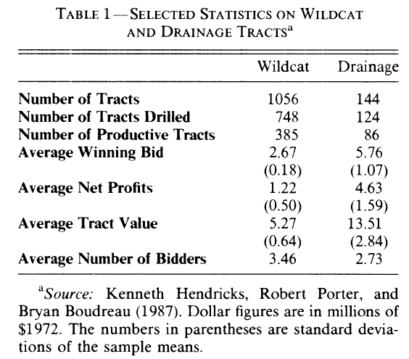
Wildcat vs Drainage

Slide 118
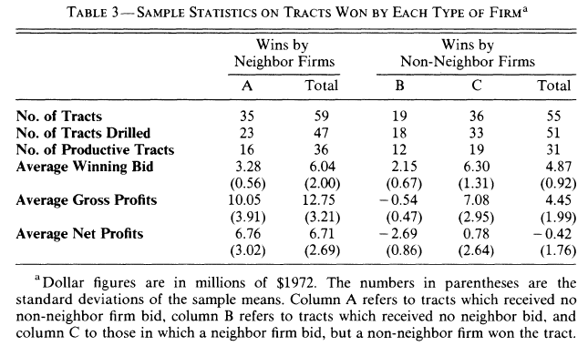
Drainage sales

Slide 119
Explaining the Results
Comparing wildcat and drainage sales
  Wildcat sales yield low profits => competition.
  Drainage sales are profitable, but only for “insiders” => insiders have an advantage.
Next slides (which we won’t cover today) work out equilibrium bidding for an “insider/outsider” model.
  This model fits the drainage data quite well.
  The symmetric model fits the wildcat data!

Slide 120
Drainage sales
Asymmetric information model
  Neighbor knows true value v.
  Outsider believes v is U[0,1].
  In ascending auction, outsider drops out at zero!
  What about first price sealed bid auction?
Captures the idea that the bidder with the neighboring tract has superior information.

Slide 121
Bidding in drainage model
There is no equilibrium in which the outsider uses a “pure” strategy.
  Suppose the neighbor expects the outsider to bid b.
  Neighbor will bid b if b>v, or else less than b.
  So the outsider wins and pays b if and only if v<b.
  Therefore b>0 can’t be optimal, and there can’t be an equilibrium in which the outsider bids b>0 for sure.
  There also can’t be an equilibrium with b=0. The neighbor would also bid zero (or epsilon), and the outsider could profitably bid just a bit more and win for sure.

Slide 122
Mixed strategy equilibrium
In equilibrium, the outsider randomizes between different bids – each bid gives him an expected payoff of zero.
  Outsider bids less than x with probability P(x)=2x.
  Neighbor bids b(v)=v/2 if value is v.
Features of the equilibrium
  Bids of both bidders are uniformly distributed on [0,1/2].
  The neighbor wins exactly half the time, but tends to win when v is high, and makes positive profit.
  The outsider also wins half the time, but makes zero profit on average.

Slide 123
Verifying the equilibrium
Outsider profit (equals zero for all bids x)
  Profit from bidding x: π(x)=Pr(b(v)<x)(E[v|b(v)<x]-x)
  Define g(x)=b⁻¹(x): π(x)=Pr(v<g(x))(E[v|v<g(x)] x)
  So, π(x)=g(x)*[g(x)/2-x]=0
Therefore g(x)=2x and b(v)=v/2.

Slide 124
Verifying the equilibrium
Neighbor’s problem
  Given v, choose bid b to maximize P(b)(b-v)
  Neighbor’s first order condition: b=v-P(b)/P’(b)
But we know b(v)=v/2, so therefore P(b)=2b.

Slide 125
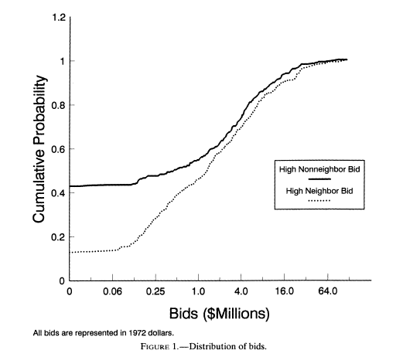
Testing equal distributions

Slide 126
Summary
Many auctions have a “common value flavor.
In common value auctions
  Auctions that aggregate participant information into the price can yield more revenue.
  If there are many bidders, the resulting price can be a useful indicator of the item’s value.
  The distribution of information is very important.

